Slide 1
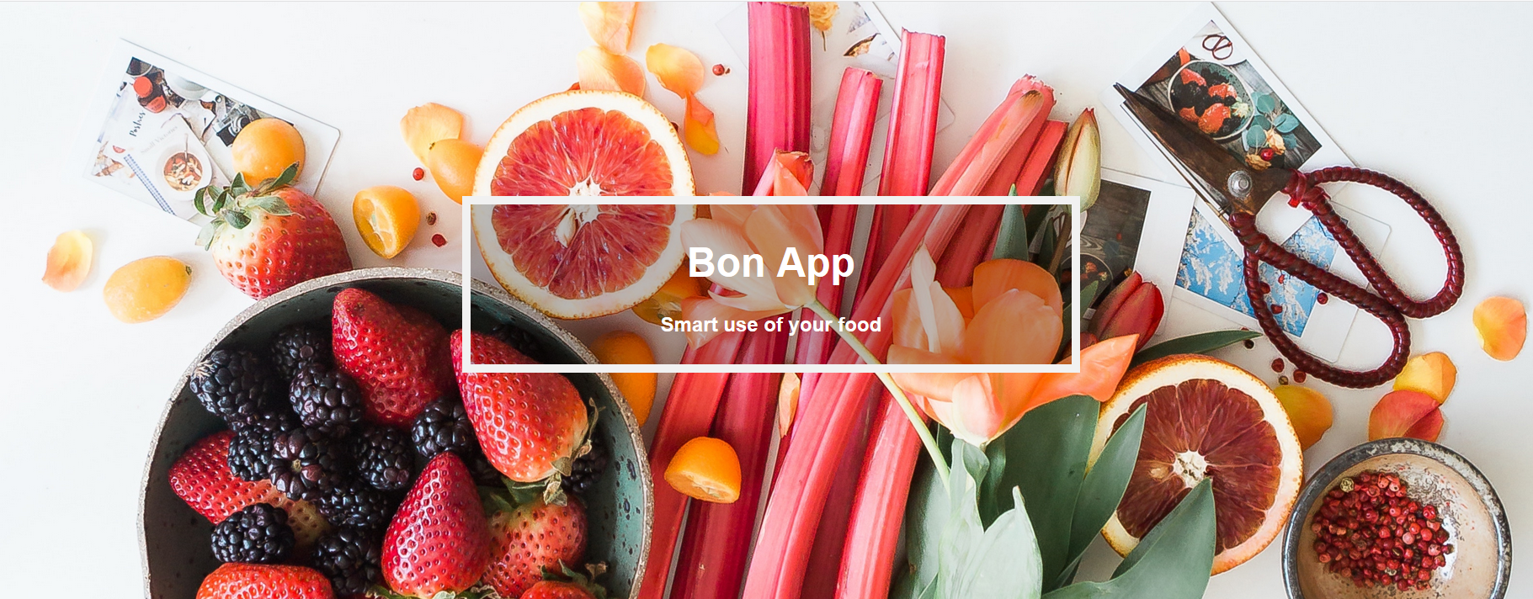
Project: Hackmeat
25. November 2018

Slide 2
Table of Content
Use Cases
Live Demo
Challanges
Technically
Further Developments

Slide 3


Use Cases
As a hungry monster I want a recipe, based on ingredients I have at home and filter them by personal preferences.
As a hungry monster I want a shopping-list of the ingredients I have to buy, based on the recipe I choose.
As a lazy monster I want to scan my bill to add my shopping to the stock list.

Slide 4

Live Demo

Slide 5

Challenges
Big Team - to organization the tasks
The Search Algorithm
Understanding of Algolia (NoSQL)
Extracting the needed Information from Google Cloud Vision

Slide 6

Technically
GUI
Post Picture
Convert Picture into Text
Google Cloud Vision
Bill Scanner
Get Stocke
Post Shopping
Post Shopping
Search-Service
DB-Service
Algolia
Post Items into the Stock
Recipes
Incredients
Stock

Slide 7

Challenges
Big Team - to organization the tasks
The Search Algorithm
Understanding of Algolia (NoSQL)
Extracting the needed Information from Google Cloud Vision

Slide 8

Further Developments
Connection to a Food E-Shop
Consume recommendation (Food Waste)
Scanning Recipes
Connection to a Smart-Fridge
Connection to Alexa, Bixby, etc.
App for the Phone
Budgetplan for Commune

Slide 9

Question?

